Slide 1

Database Systems
Department of Computer Science
Chungbuk National University
Prof. Jong Yun LEE

Slide 2
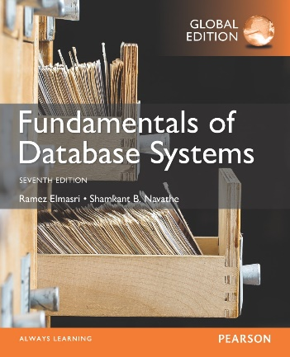
CHAPTER 7: More SQL: Complex Queries, Triggers, Views, and Schema Modification

Slide 3
Chapter 7 Outline
More Complex SQL Retrieval Queries
Specifying Semantic Constraints as Assertions and Actions as Triggers
Views (Virtual Tables) in SQL
Schema Modification in SQL

Slide 4
More Complex SQL Retrieval Queries

Slide 5
More Complex SQL Retrieval Queries
Additional features allow users to specify more complex retrievals from database:
Nested queries, joined tables, and outer joins (in the FROM clause), aggregate functions, and grouping

Slide 6
Comparisons Involving NULL and Three-Valued Logic
Meanings of NULL
Unknown value
Unavailable or withheld value
Not applicable attribute
Each individual NULL value considered to be different from every other NULL value
SQL uses a three-valued logic:
TRUE, FALSE, and UNKNOWN (like Maybe)
NULL = NULL comparison is avoided

Slide 7
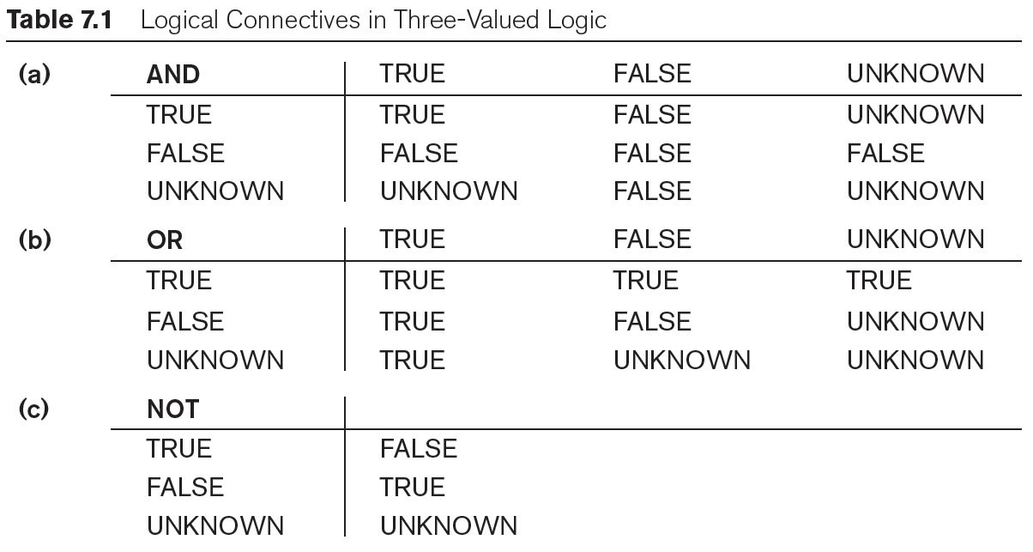
Comparisons Involving NULL and Three-Valued Logic (cont’d.)

Slide 8
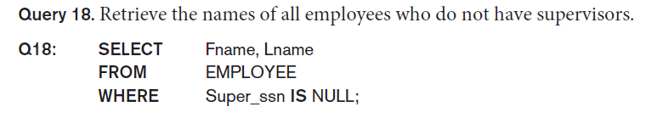
Comparisons Involving NULL and Three-Valued Logic (cont’d.)
SQL allows queries that check whether an attribute value is NULL
IS or IS NOT NULL

Slide 9
Comparisons Involving NULL and Three-Valued Logic (cont’d.)
mysql> desc current_dept_emp;
+-----------+---------+------+-----+---------+-------+
| Field | Type | Null | Key | Default | Extra |
+-----------+---------+------+-----+---------+-------+
| emp_no | int(11) | NO | | NULL | |
| dept_no | char(4) | NO | | NULL | |
| from_date | date | YES | | NULL | |
| to_date | date | YES | | NULL | |
+-----------+---------+------+-----+---------+-------+
4 rows in set (0.00 sec)
mysql> SELECT emp_no from current_dept_emp WHERE from_date IS NULL;
Empty set (0.33 sec)
mysql>

Slide 10
Nested Queries, Tuples, and Set/Multiset Comparisons
Nested queries
Complete select-from-where blocks within WHERE clause of another query
Outer query and nested subqueries
Comparison operator IN
Compares value v with a set (or multiset) of values V
Evaluates to TRUE if v is one of the elements in V

Slide 11
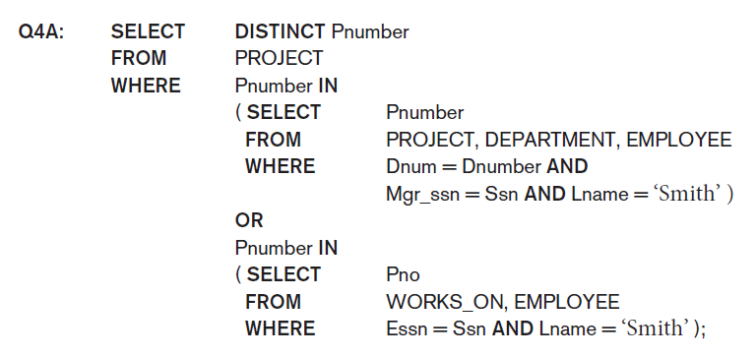
Nested Queries (cont’d.)

Slide 12
Nested Queries (cont’d.)
mysql> SELECT emp_no FROM dept_emp WHERE emp_no IN ( SELECT emp_no FROM current_dept_emp WHERE dept_no = 'd001') limit 5;
+--------+
| emp_no |
+--------+
| 10017 |
| 10055 |
| 10058 |
| 10108 |
| 10108 |
+--------+
5 rows in set (0.29 sec)
mysql>

Slide 13
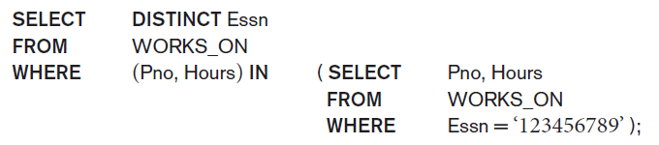
Nested Queries (cont’d.)
Use tuples of values in comparisons
Place them within parentheses
mysql> SELECT emp_no FROM dept_emp WHERE (emp_no, dept_no) IN (SELECT emp_no, dept_no FROM dept_emp WHERE dept_no = 'd001') limit 3;
+--------+
| emp_no |
+--------+
| 10017 |
| 10055 |
| 10058 |
+--------+
3 rows in set (0.00 sec)
mysql>

Slide 14
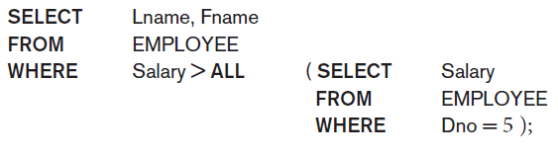
Nested Queries (cont’d.)
Use other comparison operators to compare a single value v
= ANY (or = SOME) operator
Returns TRUE if the value v is equal to some value in the set V and is hence equivalent to IN
Other operators that can be combined with ANY (or SOME): >, >=, <, <=, and <>
ALL: value must exceed all values from nested query

Slide 15
Nested Queries (cont’d.)
mysql> desc current_dept_emp;
+-----------+---------+------+-----+---------+-------+
| Field | Type | Null | Key | Default | Extra |
+-----------+---------+------+-----+---------+-------+
| emp_no | int(11) | NO | | NULL | |
| dept_no | char(4) | NO | | NULL | |
| from_date | date | YES | | NULL | |
| to_date | date | YES | | NULL | |
+-----------+---------+------+-----+---------+-------+
4 rows in set (0.00 sec)
mysql> desc salaries;
+-----------+---------+------+-----+---------+-------+
| Field | Type | Null | Key | Default | Extra |
+-----------+---------+------+-----+---------+-------+
| emp_no | int(11) | NO | PRI | NULL | |
| salary | int(11) | NO | | NULL | |
| from_date | date | NO | PRI | NULL | |
| to_date | date | NO | | NULL | |
+-----------+---------+------+-----+---------+-------+
4 rows in set (0.00 sec)
mysql> SELECT salary FROM salaries WHERE salary > ALL (SELECT S.salary from salaries S, current_dept_emp C WHERE S.emp_no = C.emp_no AND C.dept_no = 'd001') limit 3;
+--------+
| salary |
+--------+
| 145732 |
| 145215 |
| 148820 |
+--------+

Slide 16
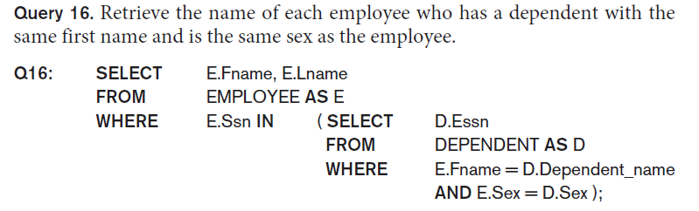
Nested Queries (cont’d.)
Avoid potential errors and ambiguities
Create tuple variables (aliases) for all tables referenced in SQL query

Slide 17
Nested Queries (cont’d.)
mysql> SELECT salary FROM salaries WHERE salary > ALL (SELECT S.salary from salaries AS S, current_dept_emp AS C WHERE S.emp_no = C.emp_no AND C.dept_no = 'd001') limit 5;
+--------+
| salary |
+--------+
| 145732 |
| 145215 |
| 148820 |
| 145300 |
| 149440 |
+--------+
5 rows in set (0.84 sec)
mysql>

Slide 18
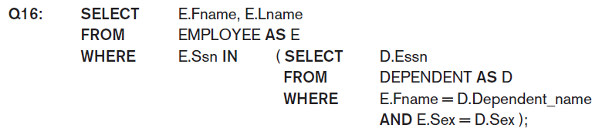
Correlated Nested Queries
Queries that are nested using the = or IN comparison operator can be collapsed into one single block: E.g., Q16 can be written as:
Q16A: SELECT E.Fname, E.Lname
FROM EMPLOYEE AS E, DEPENDENT AS D
WHERE E.Ssn=D.Essn AND E.Sex=D.Sex
AND E.Fname=D.Dependent_name;
Correlated nested query
Evaluated once for each tuple in the outer query

Slide 19
The EXISTS and UNIQUE Functions in SQL for correlating queries
EXISTS function
Check whether the result of a correlated nested query is empty or not. They are Boolean functions that return a TRUE or FALSE result.
EXISTS and NOT EXISTS
Typically used in conjunction with a correlated nested query
SQL function UNIQUE(Q)
Returns TRUE if there are no duplicate tuples in the result of query Q

Slide 20
USE of EXISTS
Q7: List the names of managers who have at least one dependent.
SELECT Fname, Lname
FROM Employee
WHERE EXISTS (SELECT *
FROM DEPENDENT
WHERE Ssn= Essn) AND
EXISTS (SELECT *
FROM Department
WHERE Ssn= Mgr_Ssn)

Slide 21
USE of EXISTS
mysql> SELECT salary FROM salaries WHERE EXISTS (SELECT S.salary from salaries AS S, current_dept_emp AS C WHERE S.emp_no = C.emp_no AND C.dept_no = 'd001') limit 5;
+--------+
| salary |
+--------+
| 60117 |
| 62102 |
| 66074 |
| 66596 |
| 66961 |
+--------+
5 rows in set (0.30 sec)
mysql>

Slide 22
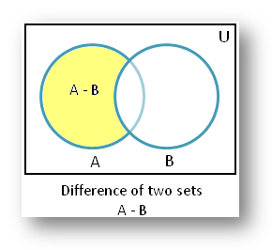
USE OF NOT EXISTS
To achieve the “for all” (universal quantifier- see Ch.8) effect, we use double negation this way in SQL:
Query: List first and last name of employees who work on ALL projects controlled by Dno=5.
SELECT Fname, Lname
FROM Employee
WHERE NOT EXISTS ( (SELECT Pnumber
FROM PROJECT
WHERE Dno=5)
EXCEPT (SELECT Pno
FROM WORKS_ON
WHERE Ssn= ESsn));
The above is equivalent to double negation: List names of those employees for whom there does NOT exist a project managed by department no. 5 that they do NOT work on.
Empty Set

Slide 23
USE OF NOT EXISTS
mysql> SELECT salary FROM salaries WHERE NOT EXISTS (SELECT S.salary from salaries AS S, current_dept_emp AS C WHERE S.emp_no = C.emp_no AND C.dept_no = 'd001') limit 5;
Empty set (0.30 sec)
mysql>
mysql> SELECT salary FROM salaries WHERE salary NOT IN (SELECT S.salary from salaries AS S, current_dept_emp AS C WHERE S.emp_no = C.emp_no AND C.dept_no = 'd001') limit 5;
+--------+
| salary |
+--------+
| 81025 |
| 85112 |
| 69366 |
| 40006 |
| 43636 |
+--------+
Note that MySQL does not support the EXCEPT, MINUS operator.

Slide 24
Double Negation to accomplish “for all” in SQL
Q3B:
SELECT Lname, Fname
FROM EMPLOYEE
WHERE NOT EXISTS ( SELECT *
FROM WORKS_ON B
WHERE ( B.Pno IN ( SELECT Pnumber
FROM PROJECT
WHERE Dnum=5)
AND
NOT EXISTS ( SELECT *
FROM WORKS_ON C
WHERE C.Essn=Ssn
AND C.Pno=B.Pno )));
The above is a direct rendering of: List names of those employees for whom there does NOT exist a project managed by department no. 5 that they do NOT work on.
Select any WORK_ON(B) tuples whose Pno is a project controlled by department 5
if there is not a WORK_ON(C) tuple with the same Pno and the same Ssn.

Slide 25
Explicit Sets and Renaming of Attributes in SQL
Can use explicit set of values in WHERE clause
Q17: SELECT DISTINCT Essn
FROM WORKS_ON
WHERE Pno IN (1, 2, 3);
mysql> SELECT DISTINCT dept_no FROM current_dept_emp;
+---------+
| dept_no |
+---------+
| d005 |
| d007 |
| d004 |
| d003 |
| d008 |
| d006 |
| d009 |
| d001 |
| d002 |
+---------+

Slide 26

Explicit Sets and Renaming of Attributes in SQL
Use qualifier AS followed by desired new name
Rename any attribute that appears in the result of a query
mysql> SELECT C.dept_no AS department_number FROM current_dept_emp AS C, employees AS E where C.emp_no = E.emp_no limit 5;
+-------------------+
| department_number |
+-------------------+
| d005 |
| d007 |
| d004 |
| d004 |
| d003 |
+-------------------+
5 rows in set (0.29 sec)

Slide 27

Specifying Joined Tables in the FROM Clause of SQL
Joined table
Permits users to specify a table resulting from a join operation in the FROM clause of a query
The FROM clause in Q1A
Contains a single joined table. JOIN may also be called INNER JOIN

Slide 28
Different Types of JOINed Tables in SQL
Specify different types of join
NATURAL JOIN
Various types of OUTER JOIN (LEFT, RIGHT, FULL )
NATURAL JOIN on two relations R and S
No join condition specified
Is equivalent to an implicit EQUIJOIN condition for each pair of attributes with same name from R and S

Slide 29
NATURAL JOIN
Rename attributes of one relation so it can be joined with another using NATURAL JOIN:
Q1B: SELECT Fname, Lname, Address
FROM (EMPLOYEE NATURAL JOIN
(DEPARTMENT AS DEPT (Dname, Dno, Mssn,
Msdate)))
WHERE Dname=‘Research’;
The above works with EMPLOYEE.Dno = DEPT.Dno as an implicit join condition

Slide 30
NATURAL JOIN
mysql> SELECT C.dept_no AS department_number FROM current_dept_emp AS C NATURAL JOIN employees AS E limit 5;
+-------------------+
| department_number |
+-------------------+
| d005 |
| d007 |
| d004 |
| d004 |
| d003 |
+-------------------+
mysql> SELECT C.dept_no AS department_number FROM current_dept_emp AS C NATURAL JOIN employees AS E WHERE C.emp_no = E.emp_no limit 5;
+-------------------+
| department_number |
+-------------------+
| d005 |
| d007 |
| d004 |
| d004 |
| d003 |
+-------------------+

Slide 31
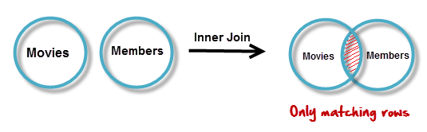
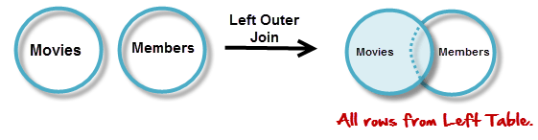
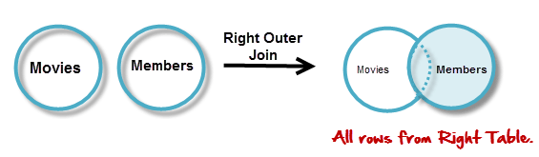
INNER and OUTER Joins
INNER JOIN (versus OUTER JOIN)
Default type of join in a joined table
Tuple is included in the result only if a matching tuple exists in the other relation
LEFT OUTER JOIN
Every tuple in left table must appear in result
If no matching tuple
Padded with NULL values for attributes of right table
RIGHT OUTER JOIN
Every tuple in right table must appear in result
If no matching tuple
Padded with NULL values for attributes of left table

Slide 32
Example: LEFT OUTER JOIN
SELECT E.Lname AS Employee_Name
S.Lname AS Supervisor_Name
FROM Employee AS E LEFT OUTER JOIN EMPLOYEE AS S
ON E.Super_ssn = S.Ssn)
ALTERNATE SYNTAX:
SELECT E.Lname , S.Lname
FROM EMPLOYEE E, EMPLOYEE S
WHERE E.Super_ssn += S.Ssn

Slide 33
Example: LEFT OUTER JOIN
mysql> SELECT C.* FROM current_dept_emp AS C LEFT JOIN employees AS E ON C.dept_no = 'd001' limit 5;
+--------+---------+------------+------------+
| emp_no | dept_no | from_date | to_date |
+--------+---------+------------+------------+
| 10017 | d001 | 1993-08-03 | 9999-01-01 |
| 10055 | d001 | 1992-04-27 | 1995-07-22 |
| 10058 | d001 | 1988-04-25 | 9999-01-01 |
| 10108 | d001 | 1999-12-06 | 2001-10-20 |
| 10140 | d001 | 1991-03-14 | 9999-01-01 |
+--------+---------+------------+------------+
5 rows in set (0.33 sec)
mysql>

Slide 34
Example: RIGHT OUTER JOIN
mysql> SELECT E.* FROM current_dept_emp AS C RIGHT JOIN employees AS E ON C.dept_no = 'd001' limit 5;
+--------+------------+------------+-----------+--------+------------+
| emp_no | birth_date | first_name | last_name | gender | hire_date |
+--------+------------+------------+-----------+--------+------------+
| 10001 | 1953-09-02 | Georgi | Facello | M | 1986-06-26 |
| 10001 | 1953-09-02 | Georgi | Facello | M | 1986-06-26 |
| 10001 | 1953-09-02 | Georgi | Facello | M | 1986-06-26 |
| 10001 | 1953-09-02 | Georgi | Facello | M | 1986-06-26 |
| 10001 | 1953-09-02 | Georgi | Facello | M | 1986-06-26 |
+--------+------------+------------+-----------+--------+------------+
5 rows in set (0.29 sec)
mysql>

Slide 35
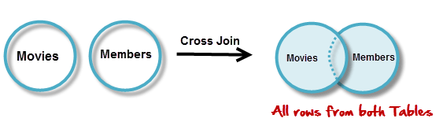
Example: CROSS JOIN (CARTESIAN PRODUCT)
mysql> SELECT E.* FROM current_dept_emp AS C CROSS JOIN employees AS E limit 5;
+--------+------------+------------+-----------+--------+------------+
| emp_no | birth_date | first_name | last_name | gender | hire_date |
+--------+------------+------------+-----------+--------+------------+
| 10001 | 1953-09-02 | Georgi | Facello | M | 1986-06-26 |
| 10002 | 1964-06-02 | Bezalel | Simmel | F | 1985-11-21 |
| 10003 | 1959-12-03 | Parto | Bamford | M | 1986-08-28 |
| 10004 | 1954-05-01 | Chirstian | Koblick | M | 1986-12-01 |
| 10005 | 1955-01-21 | Kyoichi | Maliniak | M | 1989-09-12 |
+--------+------------+------------+-----------+--------+------------+
5 rows in set (0.30 sec)
mysql>

Slide 36
Multiway JOIN in the FROM clause
FULL OUTER JOIN – combines result if LEFT and RIGHT OUTER JOIN
Can nest JOIN specifications for a multiway join:
Q2A: SELECT Pnumber, Dnum, Lname, Address, Bdate
FROM ((PROJECT JOIN DEPARTMENT ON Dnum=Dnumber) JOIN EMPLOYEE ON Mgr_ssn=Ssn)
WHERE Plocation=‘Stafford’;

Slide 37
Aggregate Functions in SQL
Used to summarize information from multiple tuples into a single-tuple summary
Built-in aggregate functions
COUNT, SUM, MAX, MIN, and AVG
Grouping
Create subgroups of tuples before summarizing
To select entire groups, HAVING clause is used
Aggregate functions can be used in the SELECT clause or in a HAVING clause

Slide 38
Renaming Results of Aggregation
Following query returns a single row of computed values from EMPLOYEE table:
Q19: SELECT SUM (Salary), MAX (Salary), MIN (Salary),
AVG (Salary)
FROM EMPLOYEE;
The result can be presented with new names:
Q19A: SELECT SUM (Salary) AS Total_Sal, MAX (Salary) AS Highest_Sal, MIN (Salary) AS Lowest_Sal, AVG (Salary) AS Average_Sal
FROM EMPLOYEE;

Slide 39
Renaming Results of Aggregation
mysql> SELECT SUM(salary), AVG(salary), MIN(salary), MAX(salary) from salaries;
+--------------+-------------+-------------+-------------+
| SUM(salary) | AVG(salary) | MIN(salary) | MAX(salary) |
+--------------+-------------+-------------+-------------+
| 181480757419 | 63810.7448 | 38623 | 158220 |
+--------------+-------------+-------------+-------------+
1 row in set (0.72 sec)
mysql>

Slide 40
Aggregate Functions in SQL (cont’d.)
NULL values are discarded when aggregate functions are applied to a particular column

Slide 41
Aggregate Functions in SQL (cont’d.)
mysql> SELECT COUNT(*) from employees;
+----------+
| COUNT(*) |
+----------+
| 300024 |
+----------+
1 row in set (0.03 sec)
mysql>

Slide 42
Aggregate Functions on Booleans
SOME and ALL may be applied as functions on Boolean Values.
SOME returns true if at least one element in the collection is TRUE (similar to OR)
ALL returns true if all of the elements in the collection are TRUE (similar to AND)

Slide 43
Grouping: The GROUP BY Clause
Partition relation into subsets of tuples
Based on grouping attribute(s)
Apply function to each such group independently
GROUP BY clause
Specifies grouping attributes
COUNT (*) counts the number of rows in the group

Slide 44
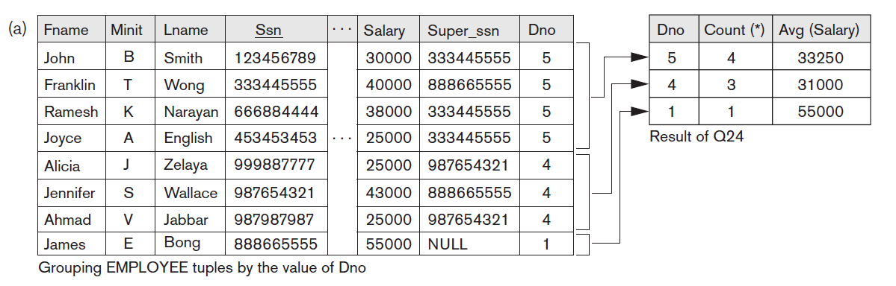
Examples of GROUP BY
The grouping attribute must appear in the SELECT clause:
Q24: SELECT Dno, COUNT (*), AVG (Salary)
FROM EMPLOYEE
GROUP BY Dno;
mysql> SELECT dept_no, COUNT(*) FROM current_dept_emp GROUP BY dept_no;
+---------+----------+
| dept_no | COUNT(*) |
+---------+----------+
| d001 | 18426 |
| d002 | 15579 |
| d003 | 16071 |
| d004 | 66675 |
| d005 | 76958 |
| d006 | 18295 |
| d007 | 46922 |
| d008 | 19285 |
| d009 | 21813 |
+---------+----------+

Slide 45
Examples of GROUP BY
If the grouping attribute has NULL as a possible value, then a separate group is created for the null value (e.g., null Dno in the above query)
GROUP BY may be applied to the result of a JOIN:
Q25: SELECT Pnumber, Pname, COUNT (*)
FROM PROJECT, WORKS_ON
WHERE Pnumber=Pno
GROUP BY Pnumber, Pname;

Slide 46
Examples of GROUP BY
mysql> SELECT dept_no, gender, COUNT(*) FROM current_dept_emp C, employees E WHERE C.emp_no = E.emp_no GROUP BY dept_no, E.gender;
+---------+--------+----------+
| dept_no | gender | COUNT(*) |
+---------+--------+----------+
| d001 | M | 11111 |
| d001 | F | 7315 |
| d002 | M | 9273 |
| d002 | F | 6306 |
| d003 | M | 9701 |
| d003 | F | 6370 |
| d004 | M | 39885 |
| d004 | F | 26790 |
| d005 | M | 46218 |
| d005 | F | 30740 |
| d006 | M | 10921 |
| d006 | F | 7374 |
| d007 | M | 28176 |
| d007 | F | 18746 |
| d008 | M | 11587 |
| d008 | F | 7698 |
| d009 | M | 13101 |
| d009 | F | 8712 |
+---------+--------+----------+

Slide 47
Grouping: The GROUP BY and HAVING Clauses (cont’d.)
HAVING clause
Provides a condition to select or reject an entire group:
Query 26. For each project on which more than two employees work, retrieve the project number, the project name, and the number of employees who work on the project.
Q26: SELECT Pnumber, Pname, COUNT (*)
FROM PROJECT, WORKS_ON
WHERE Pnumber=Pno
GROUP BY Pnumber, Pname
HAVING COUNT (*) > 2;

Slide 48
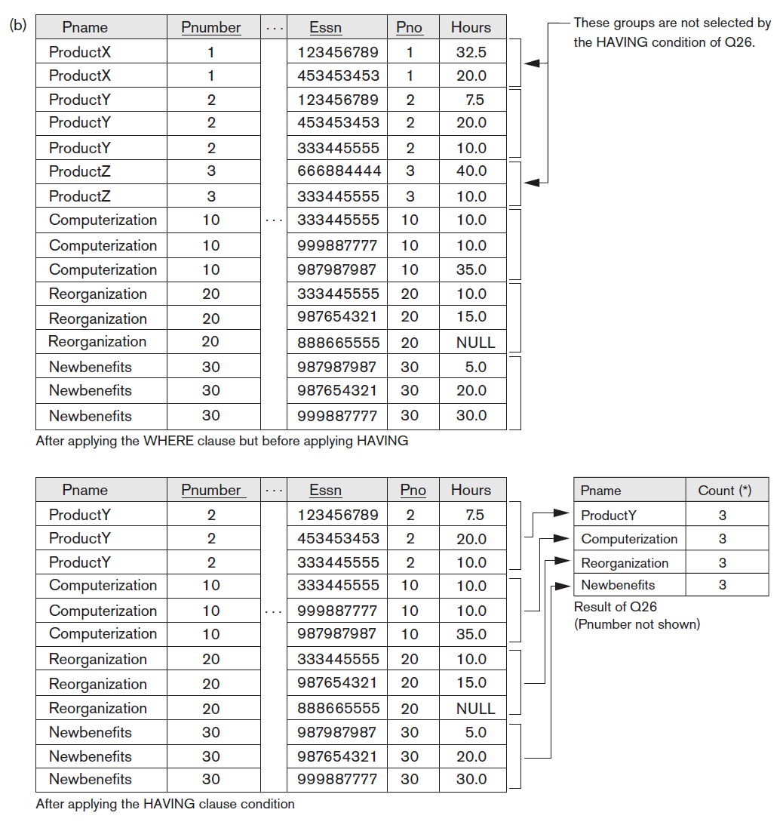
Grouping: The GROUP BY and HAVING Clauses (cont’d.)

Slide 49
Grouping: The GROUP BY and HAVING Clauses (cont’d.)
mysql> SELECT dept_no, gender, COUNT(*) FROM current_dept_emp C, employees E WHERE C.emp_no = E.emp_no GROUP BY dept_no, E.gender HAVING COUNT(*) > 10000;
+---------+--------+----------+
| dept_no | gender | COUNT(*) |
+---------+--------+----------+
| d001 | M | 11111 |
| d004 | M | 39885 |
| d004 | F | 26790 |
| d005 | M | 46218 |
| d005 | F | 30740 |
| d006 | M | 10921 |
| d007 | M | 28176 |
| d007 | F | 18746 |
| d008 | M | 11587 |
| d009 | M | 13101 |
+---------+--------+----------+
10 rows in set (1.07 sec)
mysql>

Slide 50
Combining the WHERE and the HAVING Clause
Consider the query: we want to count the total number of employees whose salaries exceed $40,000 in each department, but only for departments where more than five employees work.
INCORRECT QUERY:
SELECT Dno, COUNT (*)
FROM EMPLOYEE
WHERE Salary > 40000
GROUP BY Dno
HAVING COUNT (*) > 5;
it will select only departments that have more than five employees who each earn more than $40000.
The rule is that the WHERE clause is executed first, to select individual tuples or joined tuples; the HAVING clause is applied later, to select individual groups of tuples.

Slide 51
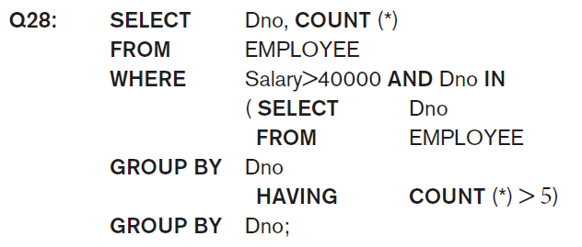
Combining the WHERE and the HAVING Clause (continued)
Correct Specification of the Query:
Note: the WHERE clause applies tuple by tuple whereas HAVING applies to entire group of tuples

Slide 52
Use of WITH
The WITH clause allows a user to define a table that will only be used in a particular query (not available in all SQL implementations)
Used for convenience to create a temporary “View” and use that immediately in a query
Allows a more straightforward way of looking a step-by-step query
A common table expression (CTE) is a named temporary result set that exists within the scope of a single statement and that can be referred to later within that statement, possibly multiple times.

Slide 53
Example of WITH
See an alternate approach to doing Q28:
Q28’: WITH BIGDEPTS (Dno) AS
(SELECT Dno
FROM EMPLOYEE
GROUP BY Dno
HAVING COUNT (*) > 5)
SELECT Dno, COUNT (*)
FROM EMPLOYEE
WHERE Salary>40000 AND Dno IN BIGDEPTS
GROUP BY Dno;

Slide 54
Use of CASE
SQL also has a CASE construct
Used when a value can be different based on certain conditions.
Can be used in any part of an SQL query where a value is expected
Applicable when querying, inserting or updating tuples

Slide 55
EXAMPLE of use of CASE
The following example shows that employees are receiving different raises in different departments (A variation of the update U6)
U6’:
UPDATE EMPLOYEE
SET Salary =
CASE WHEN Dno = 5 THEN Salary + 2000
WHEN Dno = 4 THEN Salary + 1500
WHEN Dno = 1 THEN Salary + 3000

Slide 56
EXPANDED Block Structure of SQL Queries

Slide 57
Specifying Constraints as Assertions and Actions as Triggers

Slide 58
Specifying Constraints as Assertions and Actions as Triggers
Semantic Constraints: The following are beyond the scope of the EER and relational model
CREATE ASSERTION
Specify additional types of constraints outside scope of built-in relational model constraints
CREATE TRIGGER
Specify automatic actions that database system will perform when certain events and conditions occur

Slide 59
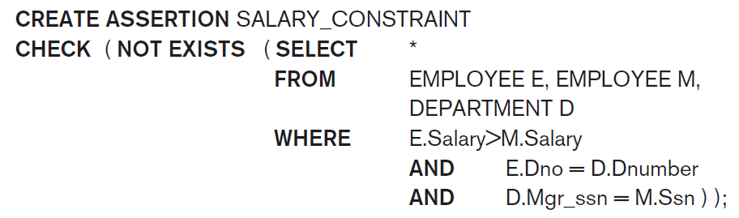
Specifying General Constraints as Assertions in SQL
CREATE ASSERTION
Specify a query that selects any tuples that violate the desired condition
Use only in cases where it goes beyond a simple CHECK which applies to individual attributes and domains

Slide 60
Introduction to Triggers in SQL
CREATE TRIGGER statement
Used to monitor the database
Typical trigger has three components which make it a rule for an “active database”:
Event(s)
Condition
Action

Slide 61
USE OF TRIGGERS
AN EXAMPLE with standard Syntax.(Note : other SQL implementations like PostgreSQL use a different syntax.)
R5:
CREATE TRIGGER SALARY_VIOLATION
BEFORE INSERT OR UPDATE OF Salary, Supervisor_ssn ON EMPLOYEE
FOR EACH ROW
WHEN (NEW.SALARY > ( SELECT Salary FROM EMPLOYEE
WHERE Ssn = NEW. Supervisor_Ssn)) INFORM_SUPERVISOR (NEW.Supervisor.Ssn, New.Ssn)

Slide 62
Views (Virtual Tables) in SQL
Concept of a view in SQL
Single table derived from other tables called the defining tables
Considered to be a virtual table that is not necessarily populated

Slide 63
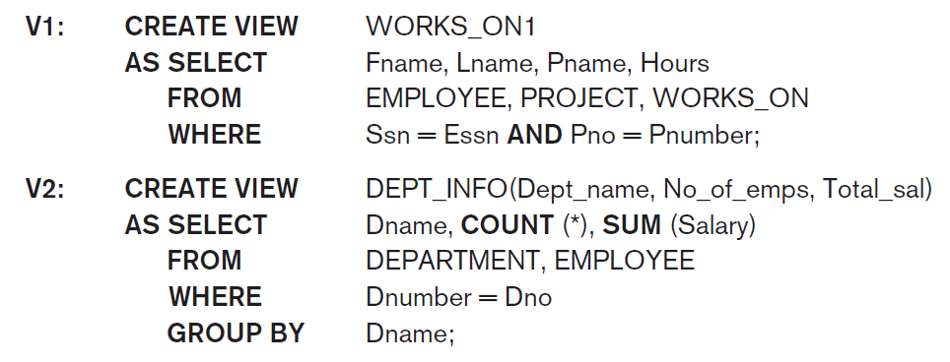
Specification of Views in SQL
CREATE VIEW command
Give table name, list of attribute names, and a query to specify the contents of the view
In V1, attributes retain the names from base tables. In V2, attributes are assigned names

Slide 64
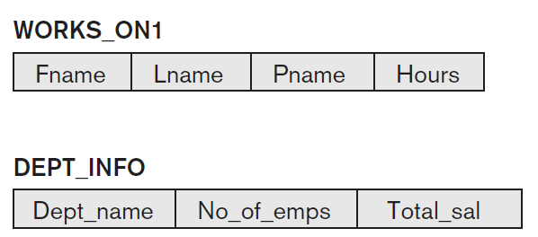
Specification of Views in SQL

Slide 65
Specification of Views in SQL (cont’d.)
Once a View is defined, SQL queries can use the View relation in the FROM clause
View is always up-to-date
Responsibility of the DBMS and not the user
DROP VIEW command
Dispose of a view

Slide 66
View Implementation, View Update, and Inline Views
Complex problem of efficiently implementing a view for querying
Strategy1: Query modification approach
Compute the view as and when needed. Do not store permanently
Modify view query into a query on underlying base tables
Disadvantage: inefficient for views defined via complex queries that are time-consuming to execute

Slide 67
View Materialization
Strategy 2: View materialization
Physically create a temporary view table when the view is first queried
Keep that table on the assumption that other queries on the view will follow
Requires efficient strategy for automatically updating the view table when the base tables are updated
Incremental update strategy for materialized views
DBMS determines what new tuples must be inserted, deleted, or modified in a materialized view table

Slide 68
View Materialization (contd.)
Multiple ways to handle materialization:
immediate update strategy updates a view as soon as the base tables are changed
lazy update strategy updates the view when needed by a view query
periodic update strategy updates the view periodically (in the latter strategy, a view query may get a result that is not up-to-date). This is commonly used in Banks, Retail store operations, etc.

Slide 69
View Update
Update on a view defined on a single table without any aggregate functions
Can be mapped to an update on underlying base table- possible if the primary key is preserved in the view
Update not permitted on aggregate views. E.g.,
UV2:
UPDATE DEPT_INFO
SET Total_sal=100000
WHERE Dname=‘Research’;
cannot be processed because Total_sal is a computed value in the view definition

Slide 70
View Update
In MySQL, views are not only query-able but also updatable. It means that you can use the INSERT or UPDATE statement to insert or update rows of the base table through the updatable view. In addition, you can use DELETE statement to remove rows of the underlying table through the view.
However, to create an updatable view, the SELECT statement that defines the view must not contain any of the following elements:
Aggregate functions such as MIN, MAX, SUM, AVG, and COUNT.
DISTINCT
GROUP BY clause.
HAVING clause.
UNION or UNION ALL clause.
Left join or outer join.
Subquery in the SELECT clause or in the WHERE clause that refers to the table appeared in the FROM clause.
Reference to non-updatable view in the FROM clause.
Reference only to literal values.
Multiple references to any column of the base table.

Slide 71
View Update and Inline Views
View involving joins
Often not possible for DBMS to determine which of the updates is intended
Clause WITH CHECK OPTION
Must be added at the end of the view definition if a view is to be updated to make sure that tuples being updated stay in the view
In-line view
Defined in the FROM clause of an SQL query (e.g., we saw its used in the WITH example)

Slide 72
Views as authorization mechanism
SQL query authorization statements (GRANT and REVOKE) are described in detail in Chapter 30
Views can be used to hide certain attributes or tuples from unauthorized users
E.g., For a user who is only allowed to see employee information for those who work for department 5, he may only access the view DEPT5EMP:
CREATE VIEW DEPT5EMP AS
SELECT *
FROM EMPLOYEE
WHERE Dno = 5;

Slide 73
Views as authorization mechanism
mysql> CREATE VIEW TEST AS SELECT * FROM dept_emp WHERE dept_no = 'd001';
Query OK, 0 rows affected (0.69 sec)
mysql>
mysql> SELECT * FROM TEST limit 5;
+--------+---------+------------+------------+
| emp_no | dept_no | from_date | to_date |
+--------+---------+------------+------------+
| 10017 | d001 | 1993-08-03 | 9999-01-01 |
| 10055 | d001 | 1992-04-27 | 1995-07-22 |
| 10058 | d001 | 1988-04-25 | 9999-01-01 |
| 10108 | d001 | 1999-12-06 | 2001-10-20 |
| 10140 | d001 | 1991-03-14 | 9999-01-01 |
+--------+---------+------------+------------+
5 rows in set (0.00 sec)
mysql> DROP VIEW TEST;
Query OK, 0 rows affected (0.00 sec)

Slide 74
Schema Change Statements in SQL

Slide 75
Schema Change Statements in SQL
Schema evolution commands
DBA may want to change the schema while the database is operational
Does not require recompilation of the database schema

Slide 76
The DROP Command
DROP command
Used to drop named schema elements, such as tables, domains, or constraint
Drop behavior options:
CASCADE and RESTRICT
Example:
DROP SCHEMA COMPANY CASCADE;
This removes the schema and all its elements including tables, views, constraints, etc.

Slide 77
The ALTER table command
Alter table actions include:
Adding or dropping a column (attribute)
Changing a column definition
Adding or dropping table constraints
Example:
ALTER TABLE COMPANY.EMPLOYEE ADD COLUMN Job VARCHAR(12);

Slide 78

Adding and Dropping Constraints
Change constraints specified on a table
Add or drop a named constraint

Slide 79
Dropping Columns, Default Values
To drop a column
Choose either CASCADE or RESTRICT
CASCADE would drop the column from views etc. RESTRICT is possible if no views refer to it.
ALTER TABLE COMPANY.EMPLOYEE
DROP COLUMN Address CASCADE;
Default values can be dropped and altered :
ALTER TABLE COMPANY.DEPARTMENT ALTER COLUMN Mgr_ssn
DROP DEFAULT;
ALTER TABLE COMPANY.DEPARTMENT
ALTER COLUMN Mgr_ssn SET DEFAULT ‘333445555’;

Slide 80
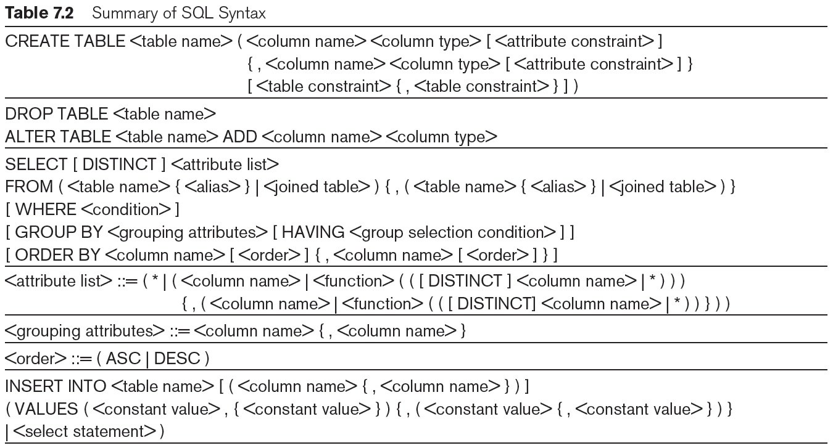
Table 7.2 Summary of SQL Syntax
continued on next slide

Slide 81
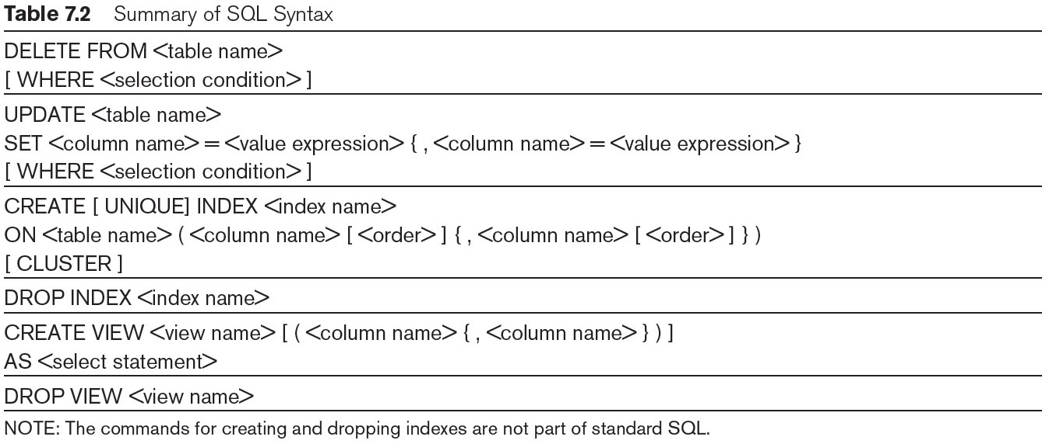
Table 7.2 (continued) Summary of SQL Syntax

Slide 82
Summary
Complex SQL:
Nested queries, joined tables (in the FROM clause), outer joins, aggregate functions, grouping
Handling semantic constraints with CREATE ASSERTION and CREATE TRIGGER
CREATE VIEW statement and materialization strategies
Schema Modification for the DBAs using ALTER TABLE, ADD and DROP COLUMN, ALTER CONSTRAINT etc.

